Slide 1
Linkage, Phasing and Haplotyping in Polyploid
Marcelo Mollinari
mmollin@ncsu.edu
Bioinformatics Research Center
Department of Horticultural Science
North Carolina State University

Slide 2
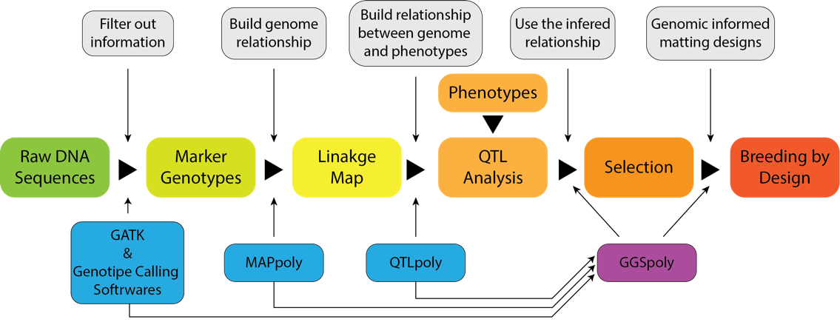
Objective
Develop computational tools for the whole pipeline data analysis in polyploids
GATK and calling software: Variant discovery and genotype calling
MAPpoly: Genetic mapping of autopolyploid species: 4x, 6x, and 8x. Also, 2x.
QTLpoly: QTL analysis in autopolyploid species: 4x, 6x, and 8x. Also, 2x.
GGSpoly: a user-friendly computational tool to assist breeders in making long and short-term breeding decisions based on collected and learned information about their breeding populations.

Slide 3
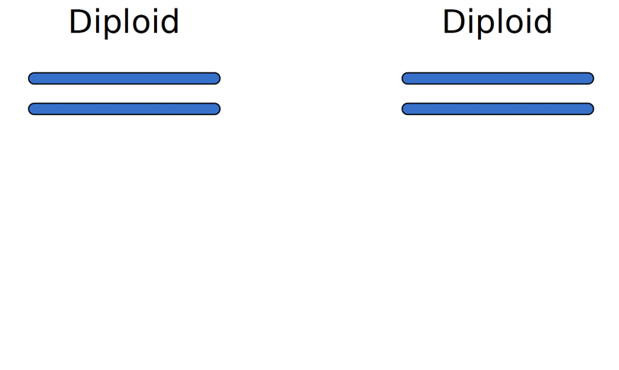
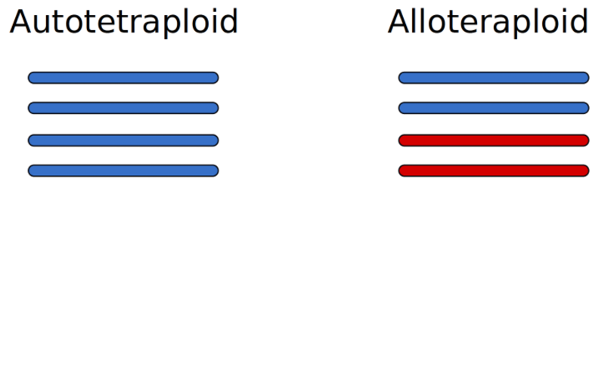
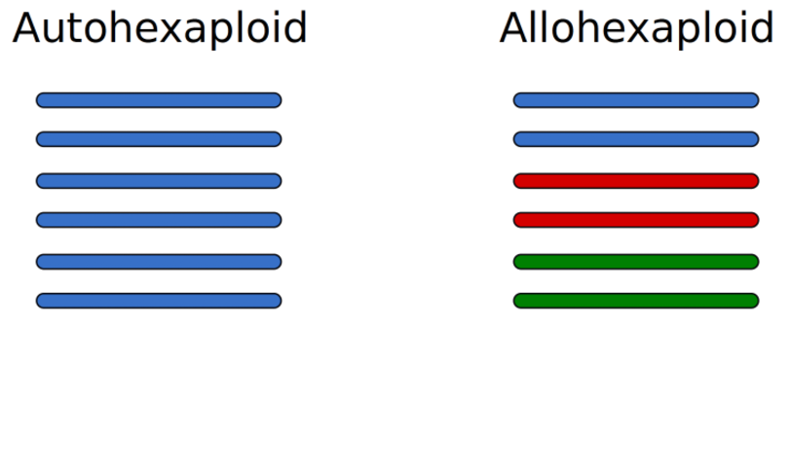

Polyploid Species
Organisms with more than 2 complete sets of chromosomes
Multiple sets have the same origin
Multiple sets have different origins

Slide 4
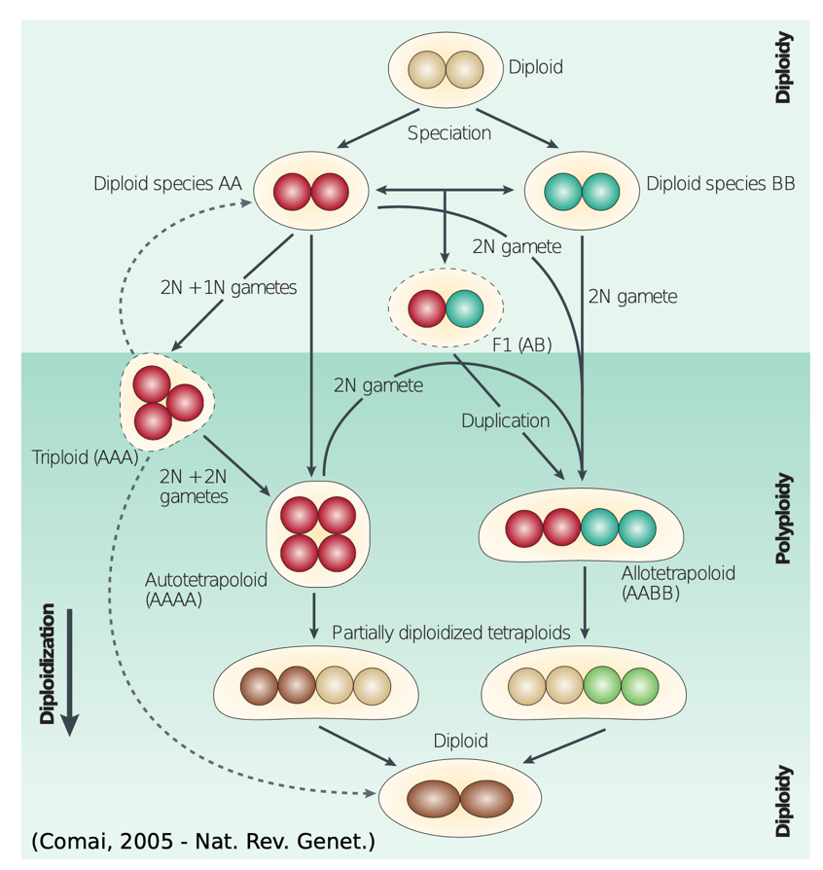
How polyploids are formed

Slide 5
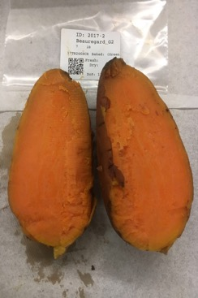
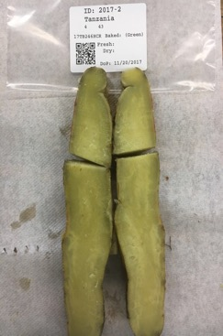
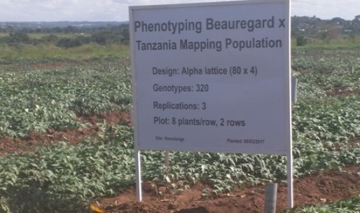
Transmission of alleles across generations Biparental cross
Beauregard x Tanzania
315 individuals
GBS – GBSpoly protocol (Bode Olukolu – U Tennessee)
Two reference genomes I. trifida and I. triloba (Zhangjun Fei’s group – BTI Cornell)
X
Beauregard
Tanzania
https://doi.org/10.1534/g3.119.400620

Slide 6
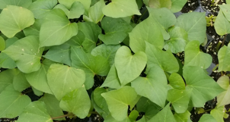
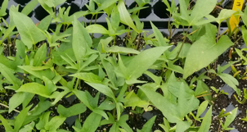
Biparental Cross - BT

Slide 7
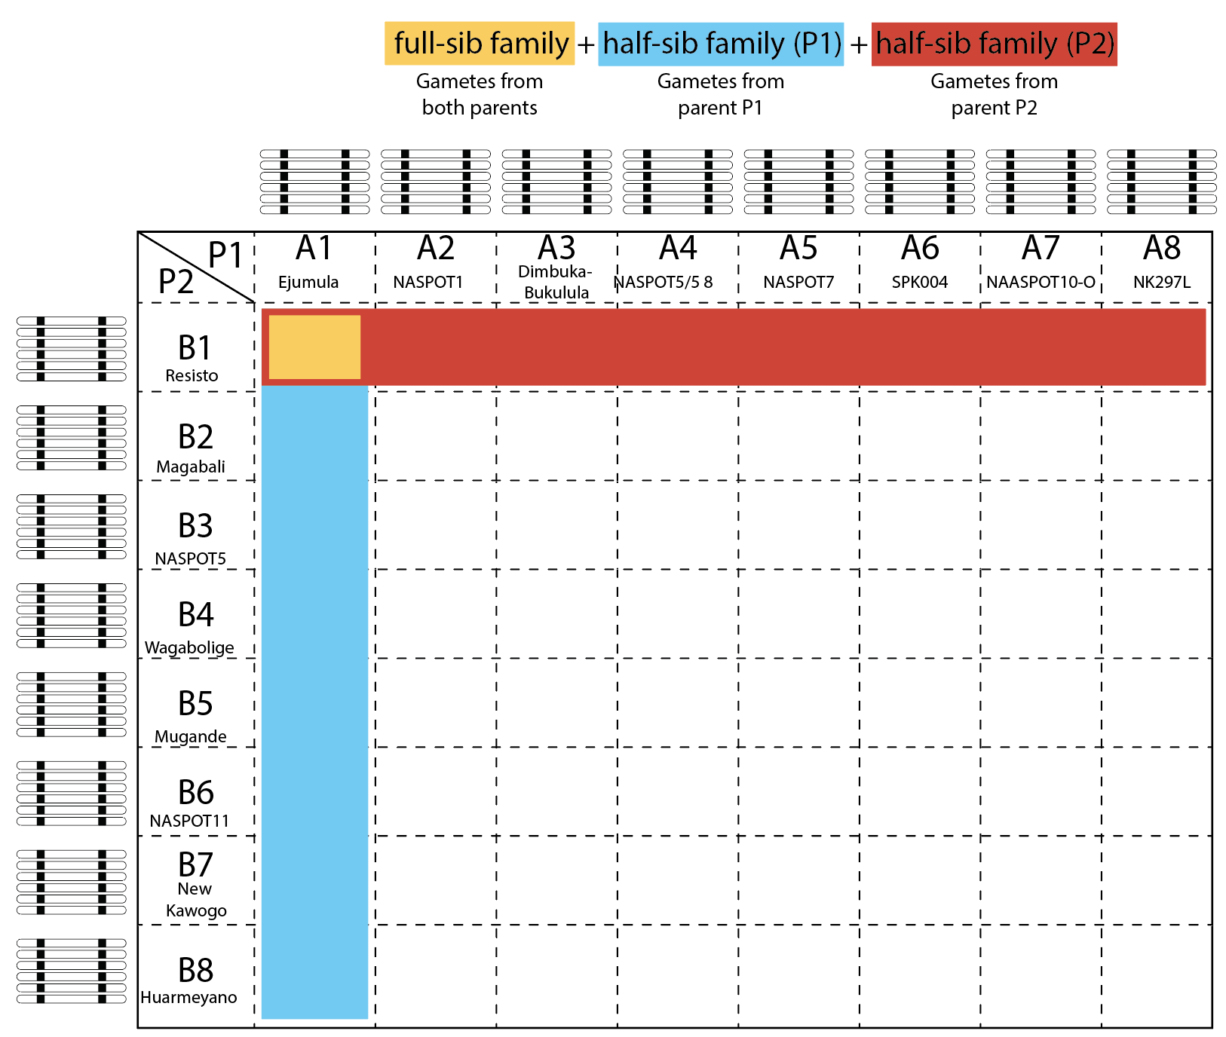
A more complex scenario Mwanga Diversity Panel (MDP) is an 8 x 8 factorial
Up to 96 different alleles at a given locus
Full-sib families ~ 30 ind.
Half-sib families ~ 240 ind.
Total ~ 1800 ind.
200 ind. hard to keep alive
Recombination fraction between markers from a joint analysis
Specific linkage phases for each parent
Reconstruct the haplotypes of each offspring in terms of the haplotypes of the 16 parents.

Slide 8
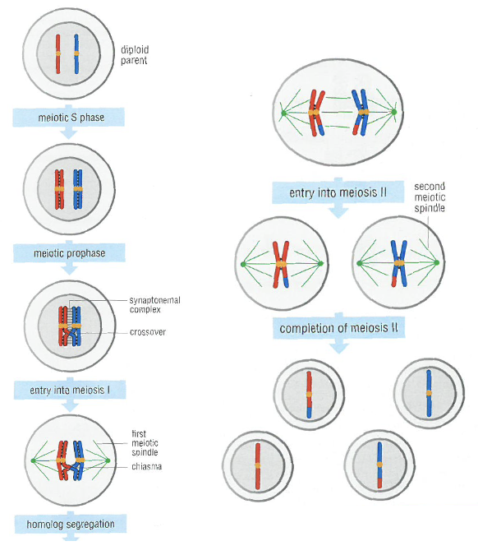
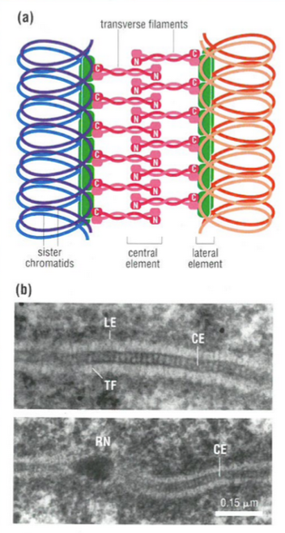
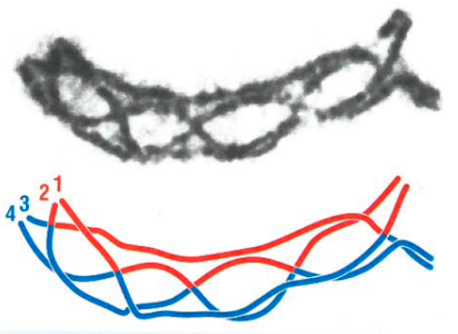
Meiosis
Meiosis is a specialized form of nuclear division that generates nuclei carrying half the normal complement of chromosomes.
Chiasmata
Synaptonemal complex

Slide 9

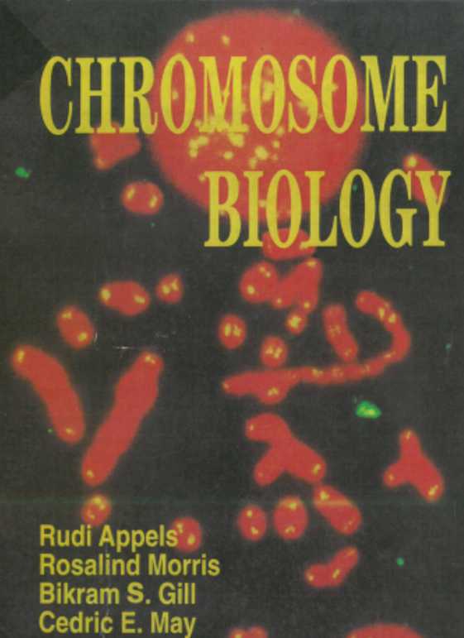

Meiosis literature

Slide 10
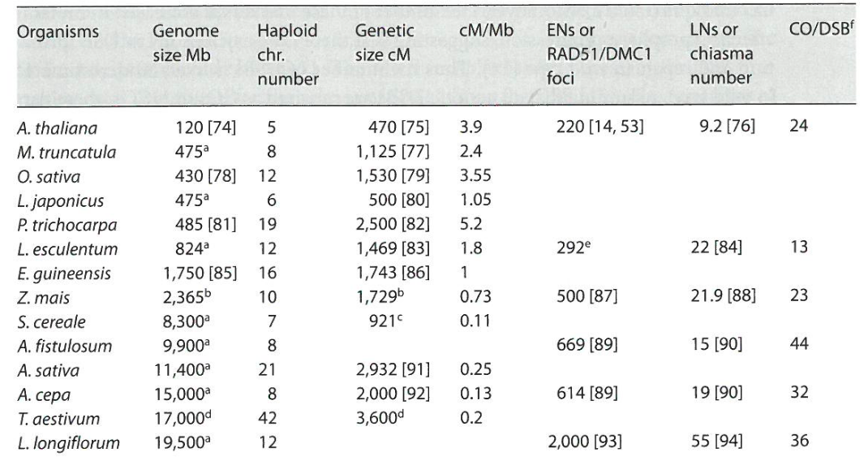
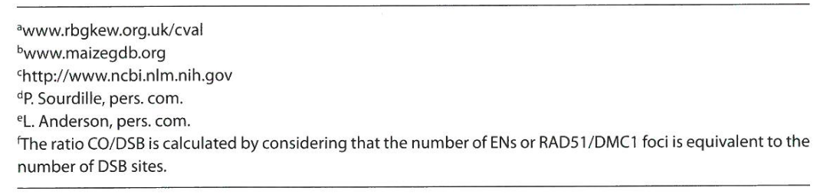
An overview of plant recombination data
Arabidopsis
Medicago
Lotus
Rice
Populus
Tomato
Palm
Maize
Rye
Green Onion
Garlic
Onion
Wheat
Lily
Sweetpotato
I. batatas
526.4
15
2,708
0.12

Slide 11
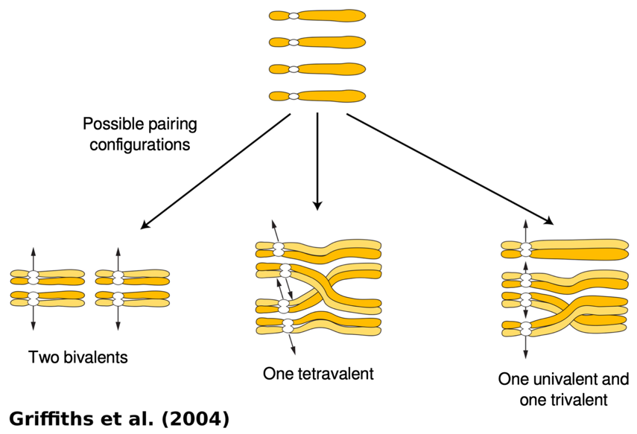
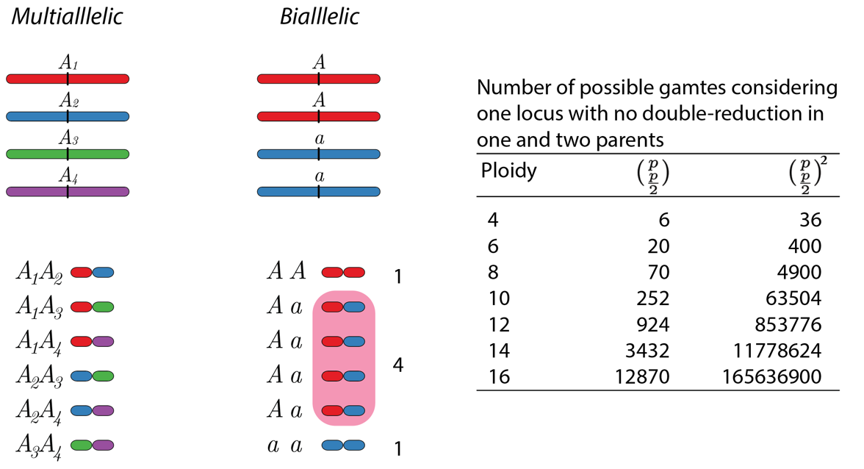
Gamete formation in polyploids*
*random pairing and no double reduction

Slide 12
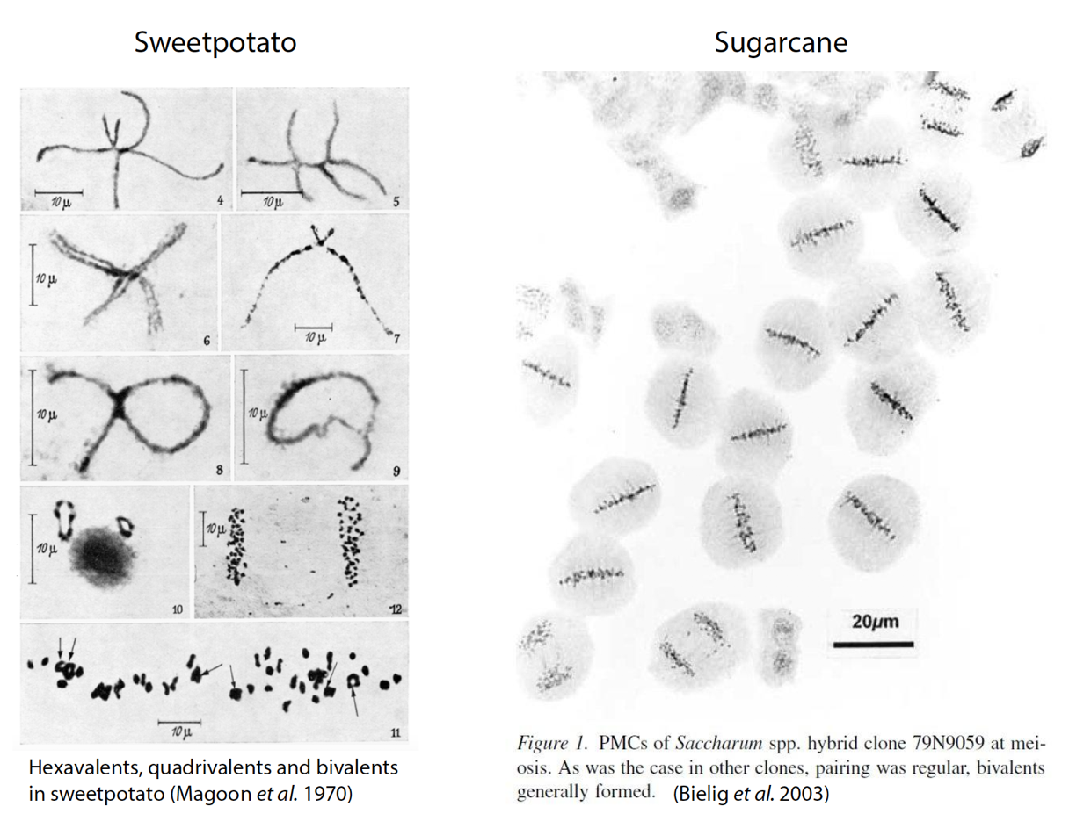
Meiotic Pairing in polyploids

Slide 13
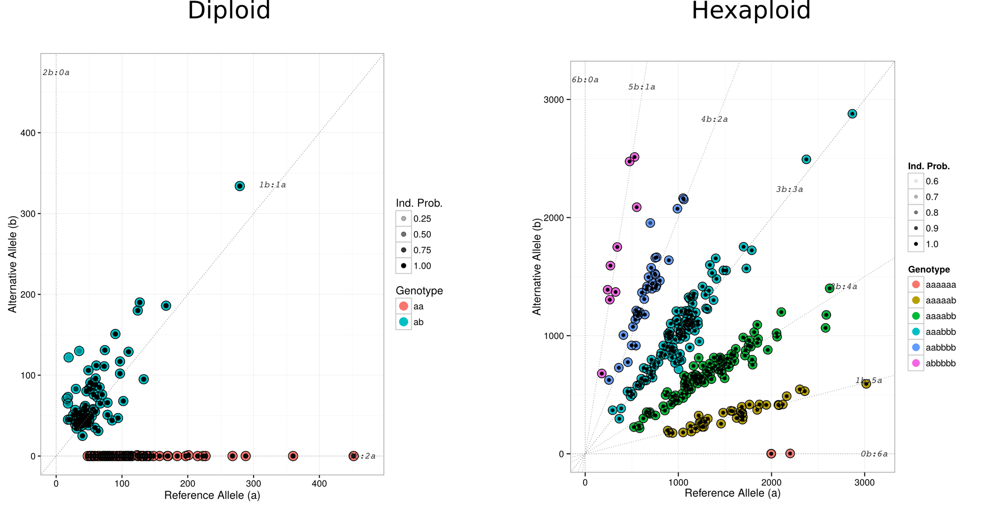
Genotyping Calling Dosage calling Including the probability distribution of the genotypes
https://doi.org/10.1371/journal.pone.0030906

Slide 14
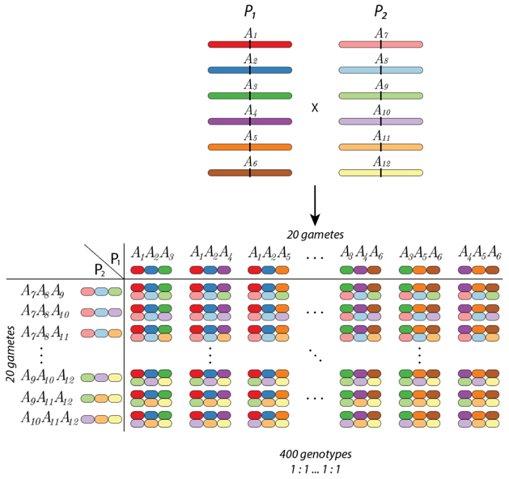
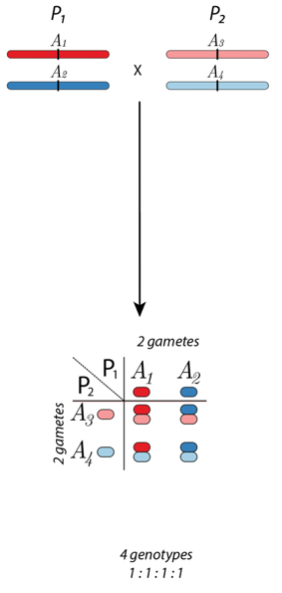
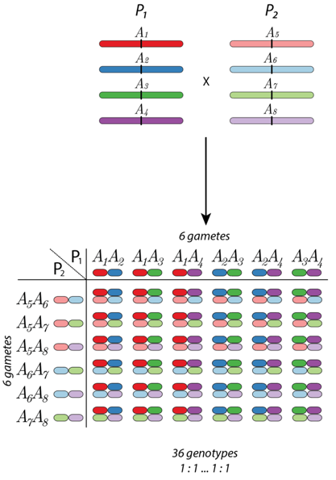
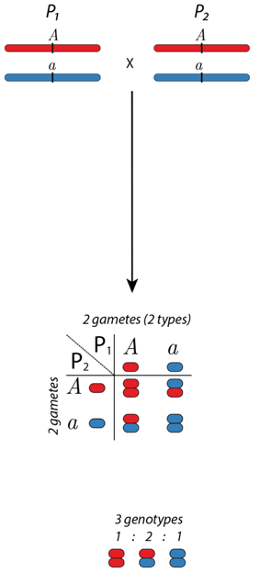
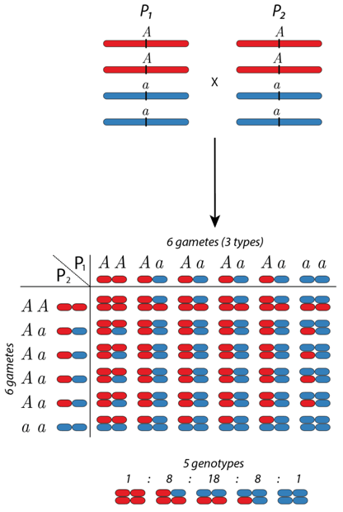
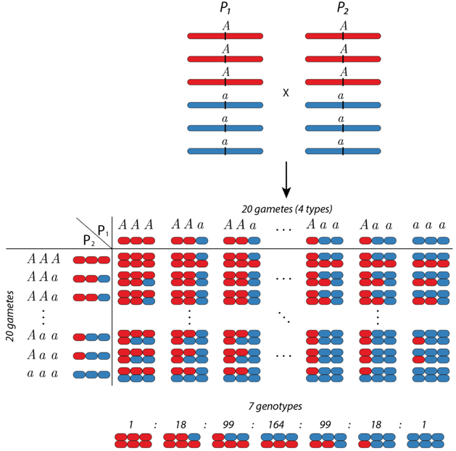
Segregation in polyploids*
Hexaploid
Diploid
Tetraploid
Multiallelic
Biallelic
*random pairing and no double reduction

Slide 15
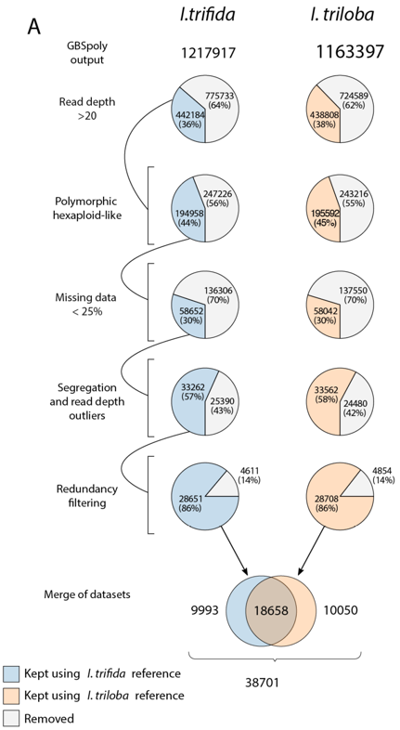
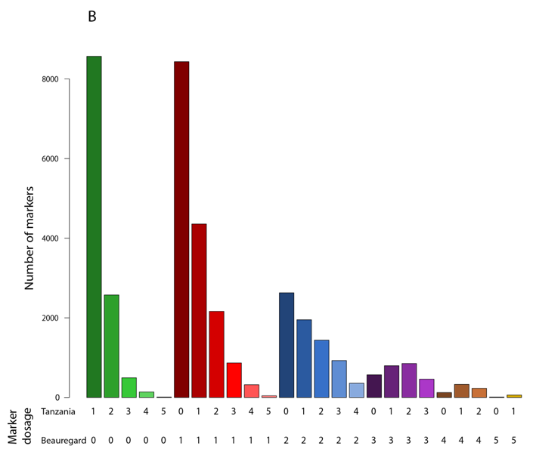
Results - Genotyping Calling - BT population
Filtering process
Distribution of the marker doses in Beauregard and Tanzania (38,701 SNPs).
https://doi.org/10.1534/g3.119.400620

Slide 16
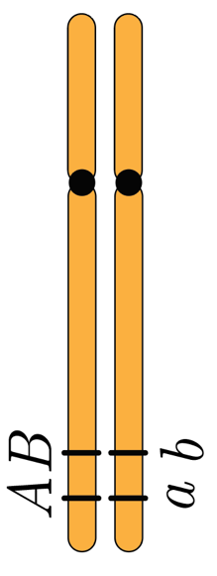
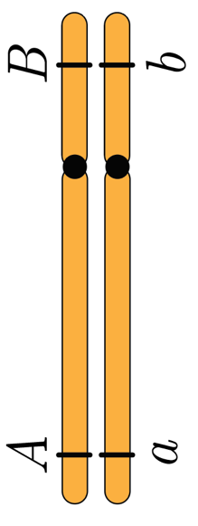
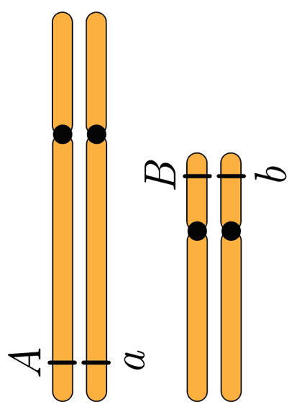
Introduction to linkage analysis
Genetic linkage is the phenomenon where markers are likely to be inherited together.
The closer the markers are, the lower the probability of crossing over events occur between them; consequently, the more likely they will be co-inherited.
Linked
Not linked
Not linked
How can we measure how likely A and B are co-inherited?

Slide 17
Introduction to linkage analysis
Genetic linkage is a concept applied to at least two loci.
We measure linkage using the recombination frequency (or fraction) in a segregating population.
Recombination frequency is the probability that an odd number of crossovers occurs between the markers. Ranges from 0.0 to 0.5 (considering double reduction this number can be higher)
We can transform these probabilistic values into distances using mapping functions. (Morgan, Haldane, Kosambi, etc.)
By computing the recombination frequencies between pairs of markers and using mapping functions, we can construct linkage maps which show the linear order and relative distance between adjacent markers.
First, let us address the behavior o a single loci across generations.

Slide 18
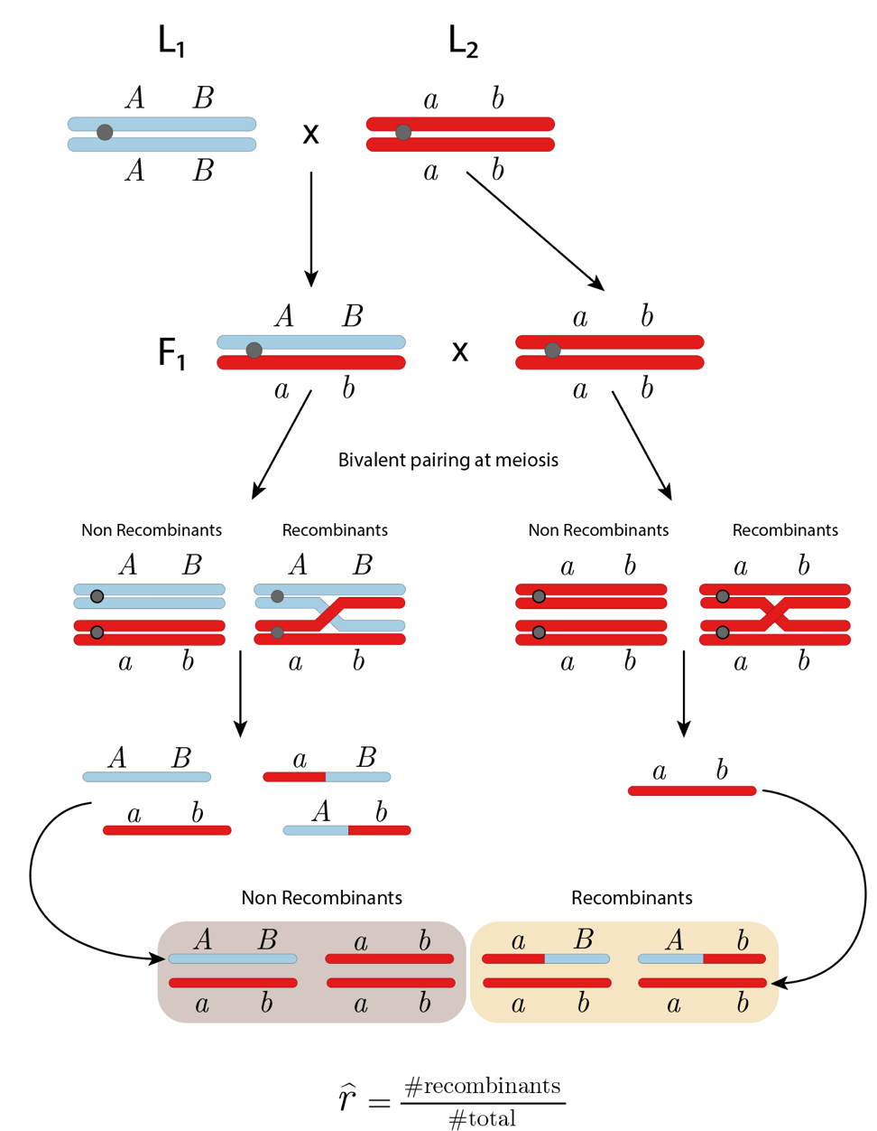
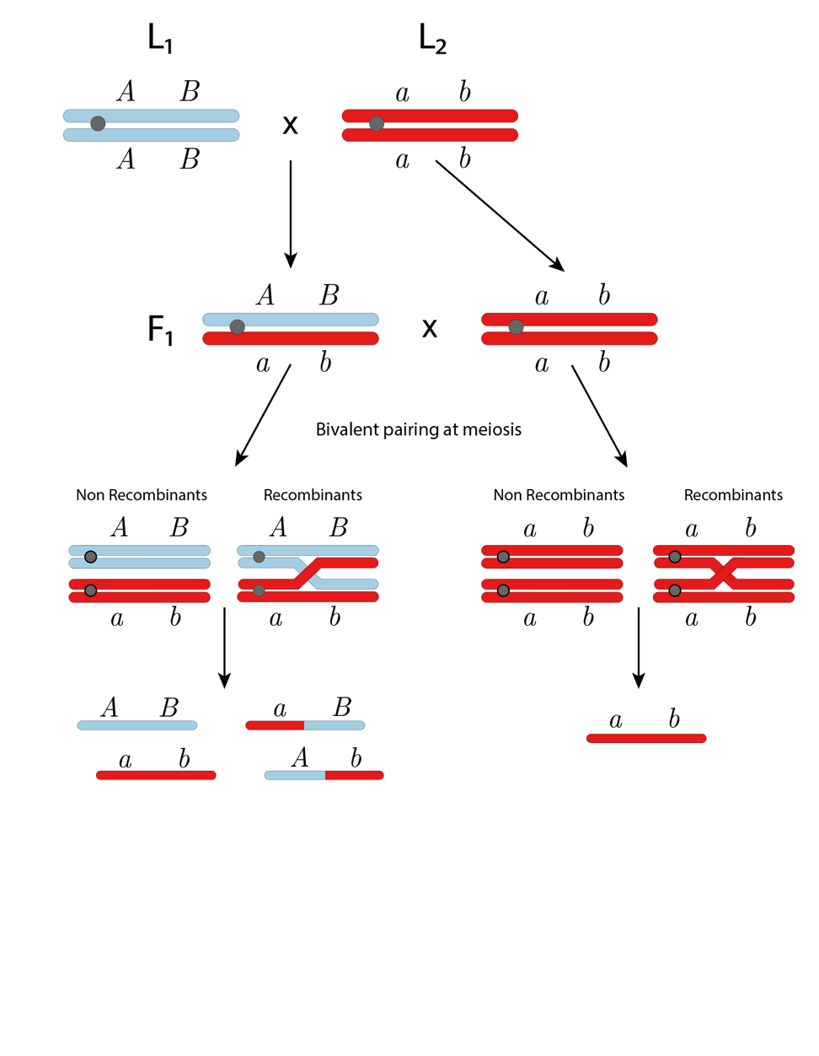
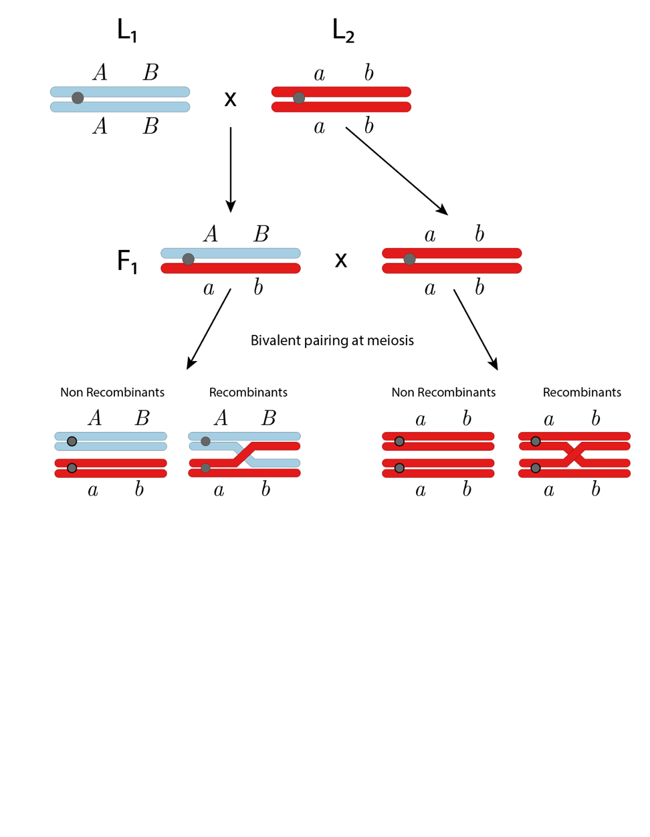
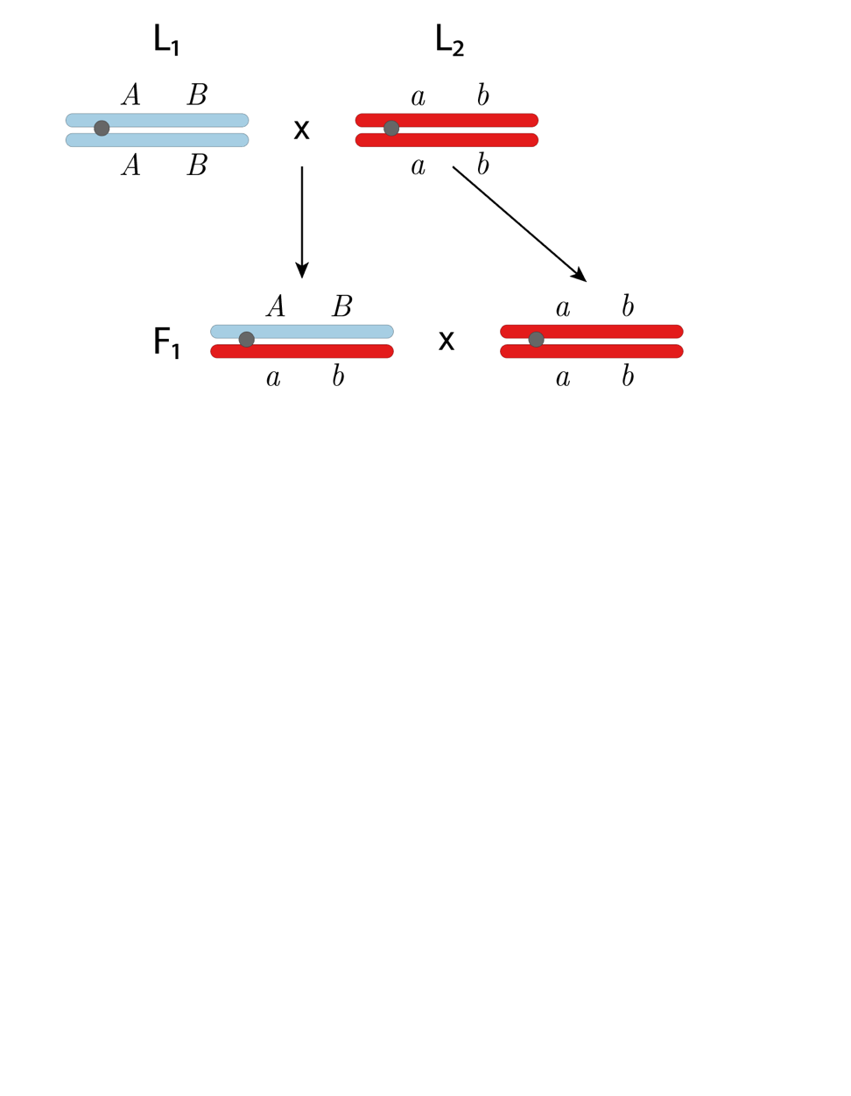
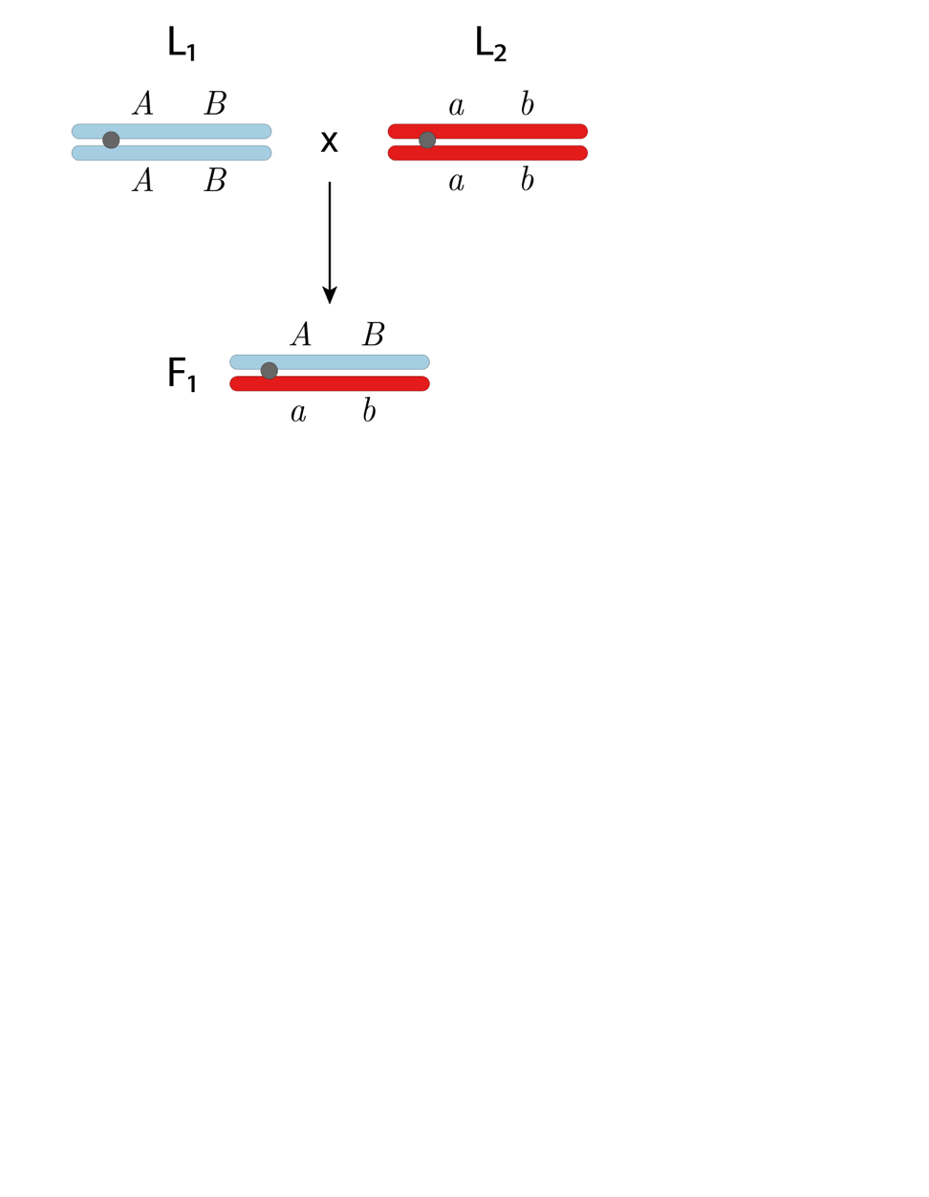
Recombination fraction in diploids

Slide 19
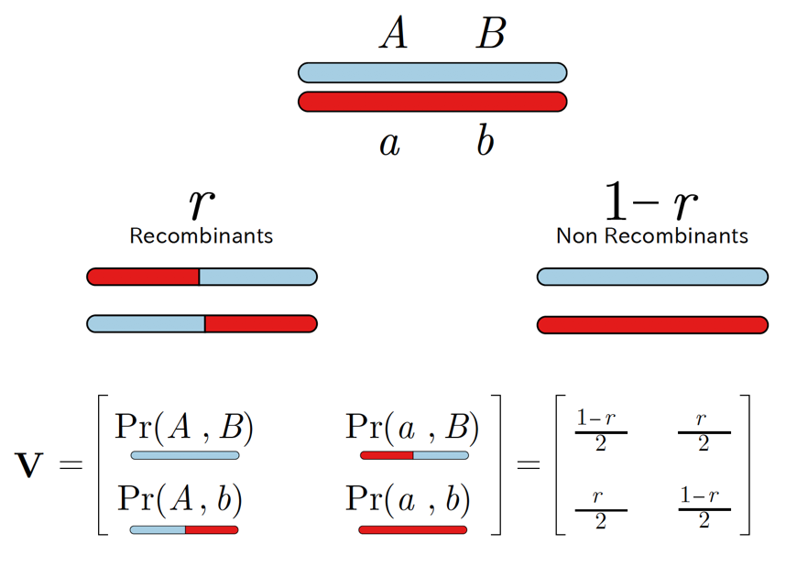
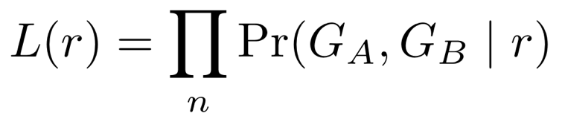
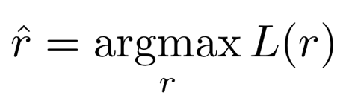
Recombination fraction in diploids - Likelihood
where n is the number of individuals. The maximum likelihood estimator of r is

Slide 20
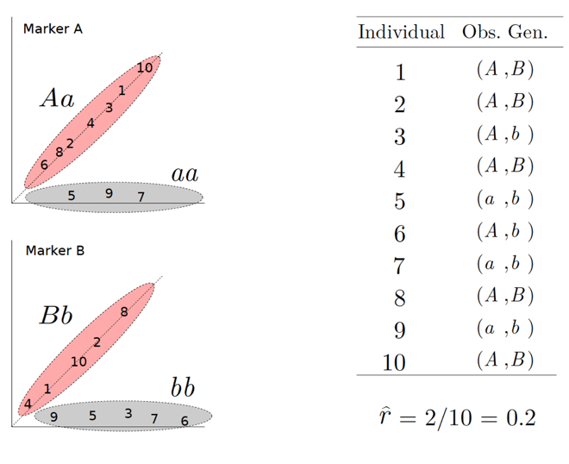
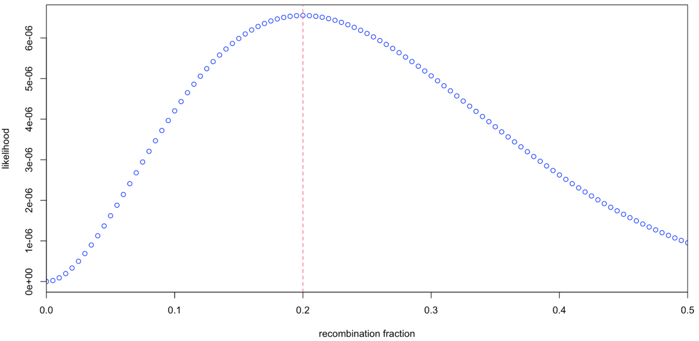
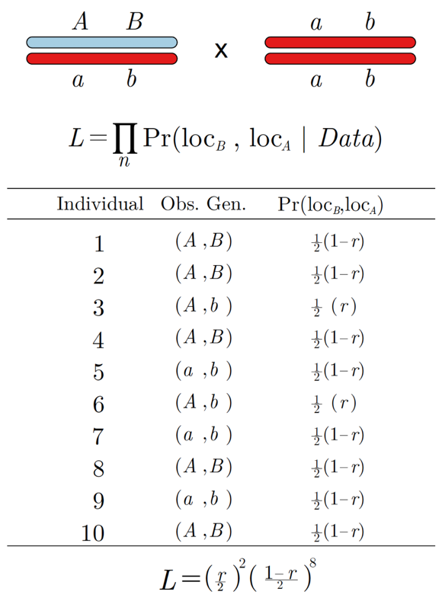
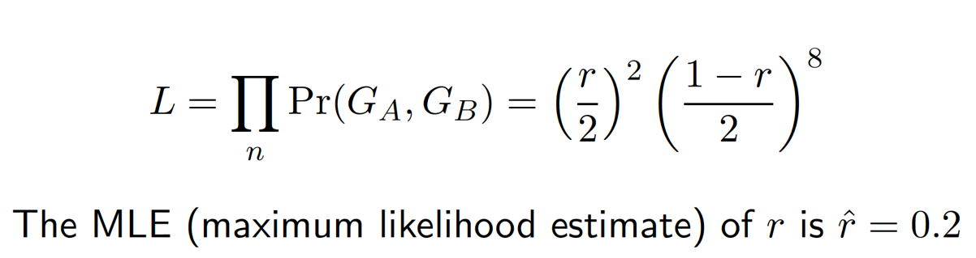
Recombination fraction in diploids
Toy example
Reference for MLE estimation in categorical data (Kalbfleisch, 1985)
https://catalog.lib.ncsu.edu/catalog/NCSU652190
Computing recombination frequencies in diploids using R and C++
https://github.com/mmollina/Cpp_and_R

Slide 21
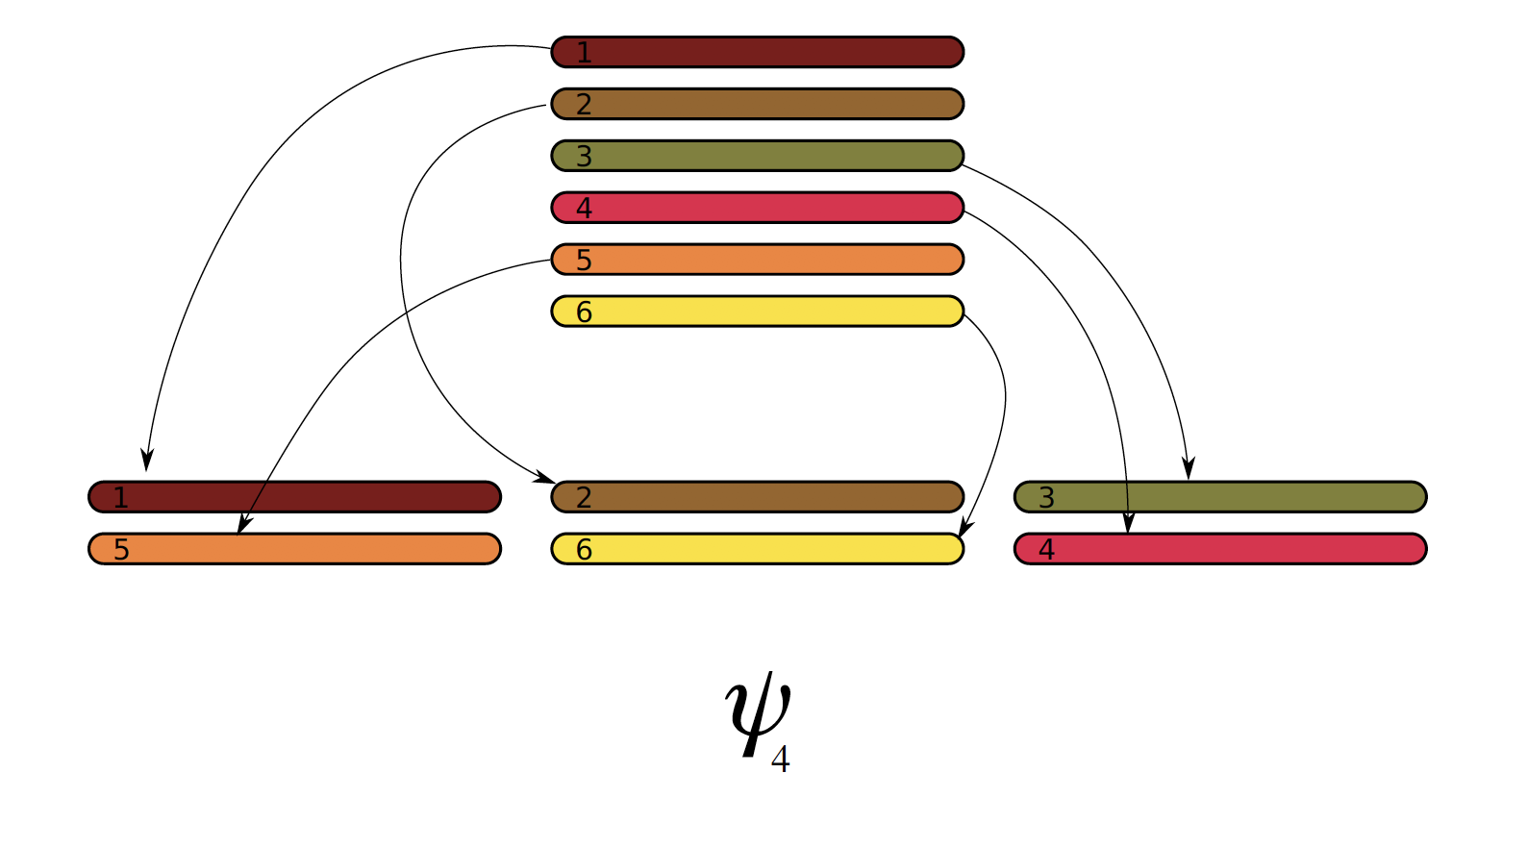
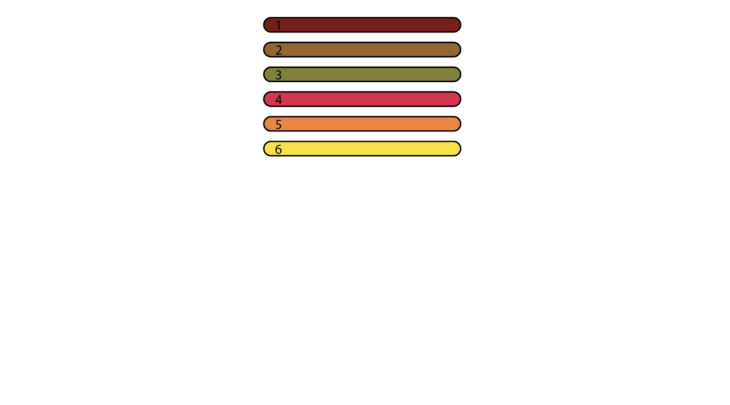
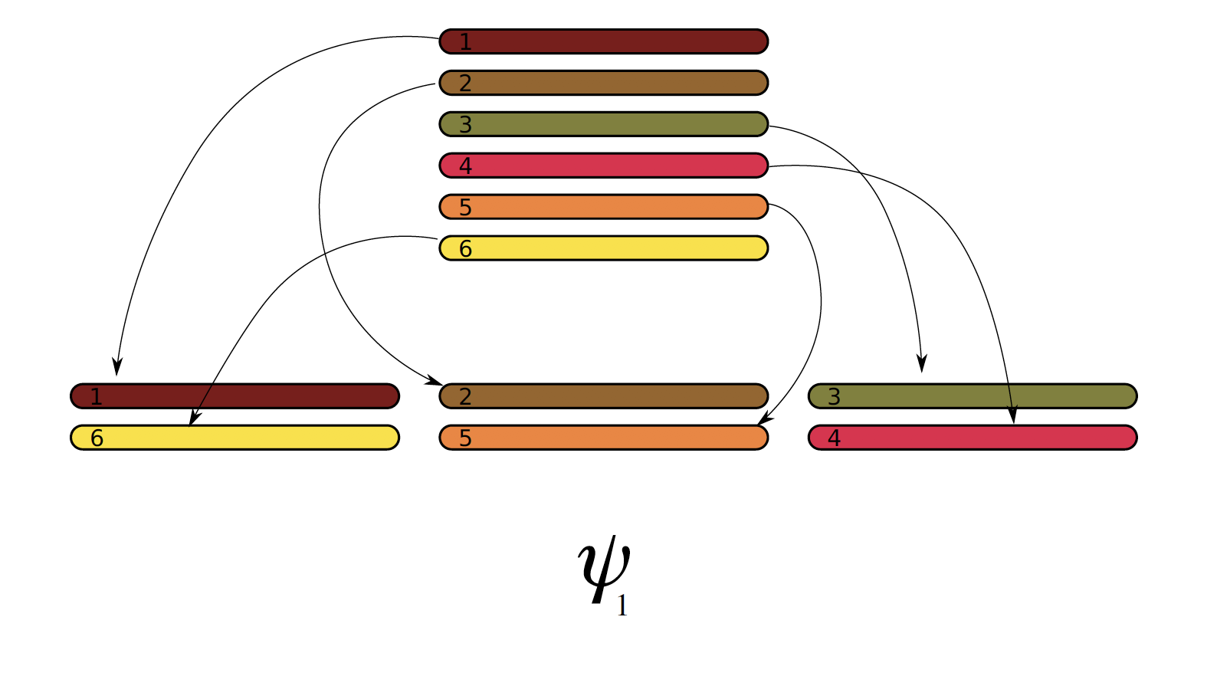
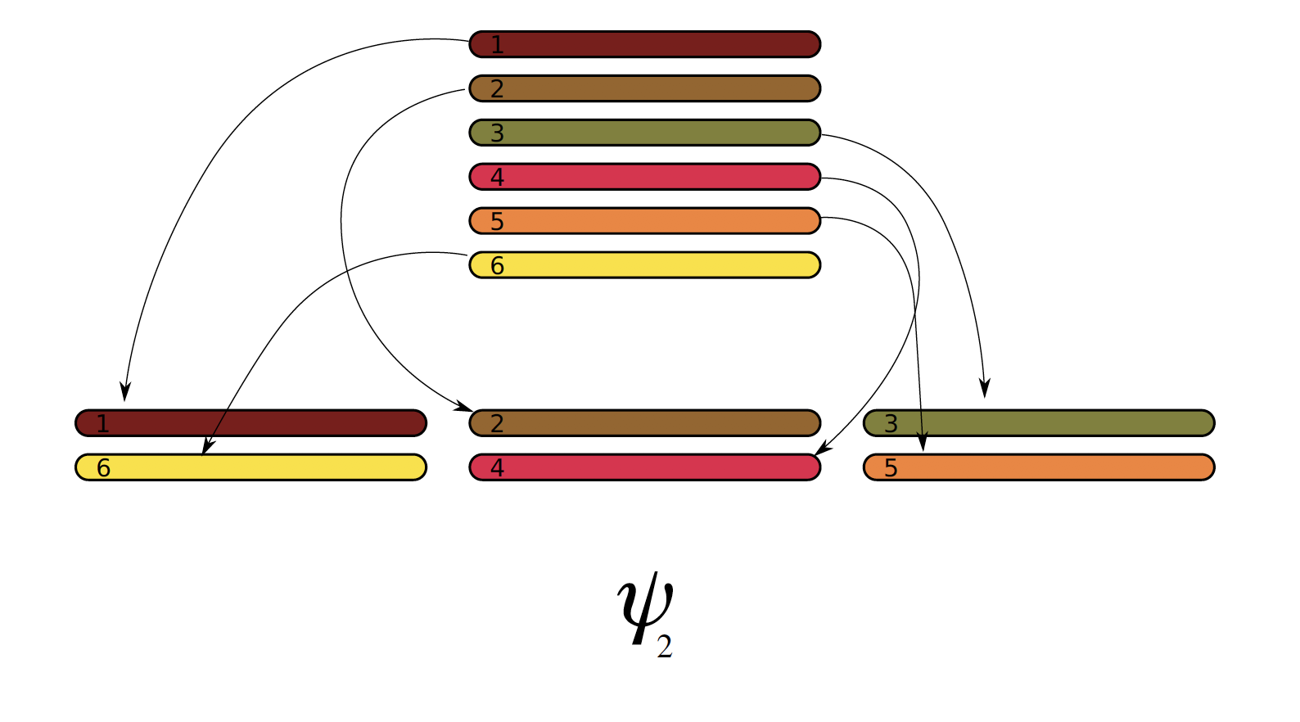
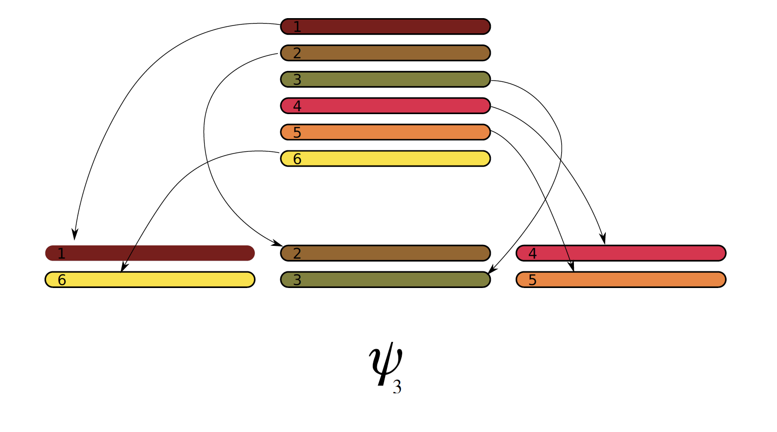
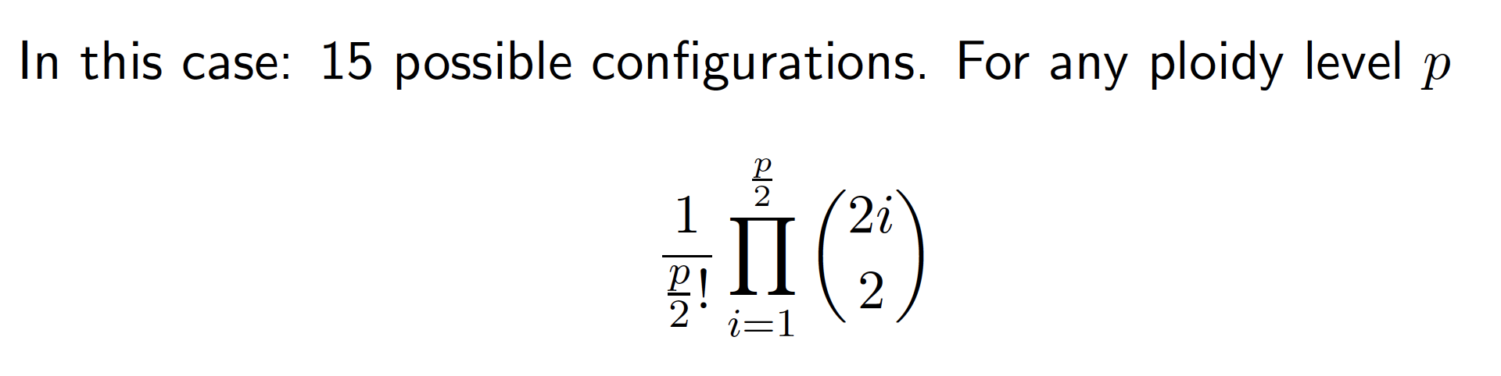
Gamete formation in polyploids*
https://doi.org/10.1534/g3.119.400378
*no double reduction

Slide 22


Expected gametic frequency given a bivalent configuration
l : known number of recombinant bivalents between loci A and B

Slide 23


Unconditional gametic probability

Slide 24





Recombination Fraction – autotetraploid
Fully informative marker

Slide 25






Recombination Fraction – autotetraploid
Partially informative marker – Duplex/simplex – Association

Slide 26






Recombination Fraction – autotetraploid
Partially informative marker – Duplex/simplex – Repulsion

Slide 27




Recombination Fraction – assessing linkage phases
logarithm-of-odds (LOD-score)
Markers A and B are most likely in association
Pairwise MLEs of r are used to group markers into linkage groups and order markers within each linkage group using optimization algorithms such as MDS.
Given a sequence of ordered markers, it is possible to extend the idea of comparing the likelihoods of competing linkage phases throughout multiple markers.
Notes:
LOD Score

Slide 28
Two – point analysis and grouping
Number of markers: 38,701
Number of recombination fractions: ~749 million pairs
Numbers indicate the associated chromosomes in I. trifida and I. triloba reference genomes

Slide 29


Multidimensional Scaling Algorithm (MDS)
Reduce data from many dimensions preserving the observed distances between points by minimizing a loss function L.
Sweetpotato linkage group 1: 2745 markers
Preedy and Hackett, 2016

Slide 30

Ordering with MDS – 15 linkage groups, 30684 SNPs
1 2 3 4 5 6 7 8 9 10 11 12 13 14 15
Numbers indicate the associated chromosomes in I. trifida and I. triloba reference genomes

Slide 31


Haplotyping in polyploids
Placement of allelic variants in the homologs in a homology group
dosages

Slide 32



Multilocus linkage analysis in polyploids
Markov Model: Conditional independence
What is the probability of observing a specific state at a moment (or position), given we observed some state in a previous moment?
where r_{k} is the recombination frequency between loci k and k+1, p is the ploidy level and l is the number of recombinant events between k and k+1.
Leach et al. (2010) doi:10.1073/pnas.0908477107
Mollinari and Garcia (2019) doi:10.1534/g3.119.400378

Slide 33






Markov model

Slide 34











Hidden Markov Model - HMM

Slide 35


Hidden Markov Model - HMM
Assessing different linkage phases using multilocus analysis

Slide 36

Hidden Markov Model - HMM
Tetraploid example, one individual, 15 markers
1 1 1 3 1 1 2 2 0 1 2 1 1 0 1

Slide 37

Hidden Markov Model - HMM
Tetraploid example, one individual, 15 markers
1 1 1 3 1 1 2 2 0 1 2 1 1 0 1

Slide 38



Strategies to improve map quality
de novo
Genome-assisted : 1.6 fold
Error modeling: 2.7 fold
Rem. low – quality ind.– 7.5 fold

Slide 39

Sweetpotato genetic map
Mollinari et al. (2020)
doi:10.1534/g3.119.400620

Slide 40

Sweetpotato genetic map

Slide 41


Genetic mapping – Linkage group 12 – 2661 SNPs
Interactive version: https://gt4sp-genetic-map.shinyapps.io/bt_map/

Slide 42

Haplotype reconstruction in the offspring
https://gt4sp-genetic-map.shinyapps.io/offspring_haplotype_BT_population/

Slide 43



Haplotype reconstruction in the offspring
https://gt4sp-genetic-map.shinyapps.io/offspring_haplotype_BT_population/

Slide 45

Preferential pairing profiles: Sweetpotato is vastly autohexaploid

Slide 46


Probabilistic haplotype reconstruction
When assuming a prior probability distribution of the genotypes, multilocus strategies can improve the quality of the inferred haplotypes
Tetraploid potato

Slide 47


Probabilistic haplotype reconstruction
Hexaploid sweetpotato

Slide 48

MAPpoly demonstration
Development version and other resources: https://github.com/mmollina/MAPpoly
Stable version: https://cran.r-project.org/package=mappoly

Slide 49
References
Haldane, J. Theoretical Genetics of Autopolyploids. J. Genet. 22, 359–372 (1930).
Mather, K. Reductional and equational separation of the chromosomes in bivalents and multivalents. J. Genet. 30, 53–78 (1935).
Mather, K. Segregation and linkage in autotetraploids. J. Genet. 32, 287–314 (1936).
Mather, K. The measurement of linkage in heredity. (1938).
Fisher, R. A. The theory of linkage in polysomic inheritance. Philos. Trans. R. Soc. Lond. B. Biol. Sci. 233, 55–87 (1947).
Ripol, M. I., Churchill, G. A., Silva, J. A. G. Da & Sorrells, M. Statistical aspects of genetic mapping in autopolyploids. Gene 235, 31–41 (1999).
Luo, Z. W., Zhang, R. M. & Kearsey, M. J. Theoretical basis for genetic linkage analysis in autotetraploid species. Proc. Natl. Acad. Sci. U. S. A. 101, 7040–7045 (2004).
Leach, L. J., Wang, L., Kearsey, M. J. & Luo, Z. Multilocus tetrasomic linkage analysis using hidden Markov chain model. Proc. Natl. Acad. Sci. U. S. A. 107, 4270–4274 (2010).
Hackett, C. a., McLean, K. & Bryan, G. J. Linkage Analysis and QTL Mapping Using SNP Dosage Data in a Tetraploid Potato Mapping Population. PLoS One 8, (2013).
Zheng, C. et al. Probabilistic Multilocus Haplotype Reconstruction in Outcrossing Tetraploids. Genetics 203, 119–131 (2016).
Bourke, P. M. Genetic mapping in polyploids. (Wageningen University, 2018).
Mollinari, M. & Garcia, A. A. F. Linkage Analysis and Haplotype Phasing in Experimental Autopolyploid Populations with High Ploidy Level Using Hidden Markov Models. G3; Genes|Genomes|Genetics 9, 3297–3314 (2019).

